Slide 1
Particle Swarm Optimisation for Neural Networks
4G4 Group Presentation
Group 8: Kim Barker, Louise Aumont, Will Halfpenny
Notes:
LOUISE
https://www.howitworksdaily.com/wp-content/uploads/2015/07/wallpaper-of-a-flock-of-flying-birds-hd-bird-wallpapers.jpg

Slide 2
Presentation Outline
Motivation
Findings
Future steps
Notes:
LOUISE
1min
https://www.wired.com/wp-content/uploads/images_blogs/wiredscience/2013/03/ff_collectives2_large.jpg

Slide 3
1. Motivation
Notes:
KIM

Slide 4
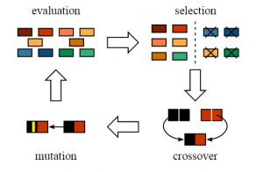
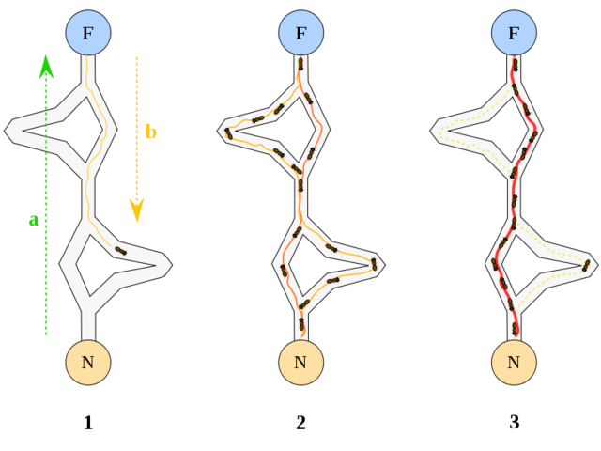
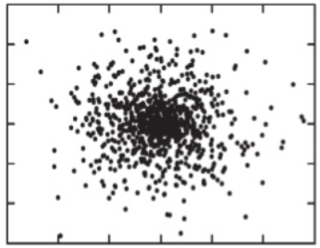
Biomimetic Algorithms
Natural metaphors
More intuitive algorithms
Can we replace back propagation with a biomimetic alternative?
Notes:
One of the major advantages of bio-inspired algorithms is that they take inspiration from concepts that we are already familiar with. They present their own natural metaphors for the algorithms being used, and this means that they are much easier to understand without a strong mathematical background. Particle swarm optimization is inspired by [background story, super brief].
https://image.slidesharecdn.com/studyofusingparticleswarmforoptimalpowerflow-140804204246-phpapp02/95/study-of-using-particle-swarm-for-optimal-power-flow-19-638.jpg?cb=1407185033
https://www.analyticsvidhya.com/blog/2017/07/introduction-to-genetic-algorithm/
http://www.collective-behavior.com/wp-content/uploads/2016/03/ant_colony_optimization.png

Slide 5
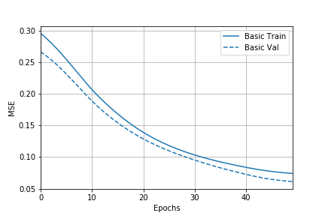
Optimization
Inspired by neural networks in the brain
Cluster data using complex relationships between inputs and outputs
Popular models in machine learning for image processing, speech recognition, medical diagnosis and forecasting.
Notes:
The other example of biomimicry inspired by biological NN. Inspired by neurons in the brain, we artificial networks of nodes analogous to neurons and weighted edges analagous to synapses which connect the input and output.
NN applications range from image processing and speech recognition to medical diagnosis and various types of forecasting.
Edges are weighted according to importance of certain connections, and hence the weights of these nodes to best map input to output is an optimisation problem. Training the weights of the edges is therefore an optimisation problem and PSO can be used to solve it.
A NN is a nonlinear statistical model, which uses a complex relationship between the inputs and outputs to identify patterns and cluster input data. It is one of the most popular machine learning methods used today. NN applications range from image processing and speech recognition to medical diagnosis and various types of forecasting. Currently, NNs are trained using complex mathematical methods, such as back-propagation (BP), which beginners will often struggle to grasp. Switching to the more intuitive method of PSO for this NN training could open up the possibility for more people to take advantage of the opportunities machine learning has to offer.
https://mag.uchicago.edu/sites/default/files/1508_Kelly_Neural-network.jpg

Slide 6
NN Training
Inspired by neural networks in the brain
Cluster data using complex relationships between inputs and outputs
Popular models in machine learning for image processing, speech recognition, medical diagnosis and forecasting.
Back propagation is the standard method for NN training today
It relies on advanced mathematics and can be challenging to understand
Is there a more intuitive NN training method?
Notes:
BP is an efficient gradient-descent method for teacher-based supervised learning in discrete, differentiable networks of arbitrary depth. It is used for fine-tuning the weights of a NN, based on the error rate obtained in the previous iteration, to ensure lower error rates, and make the model reliable by increasing its generalisation.
Edges are weighted according to importance of certain connections, and hence the weights of these nodes to best map input to output is an optimisation problem. Training the weights of the edges is therefore an optimisation problem and PSO can be used to solve it.
https://mag.uchicago.edu/sites/default/files/1508_Kelly_Neural-network.jpg

Slide 7

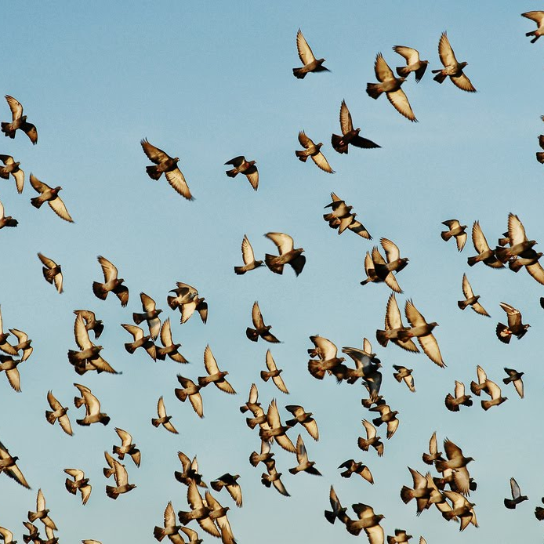
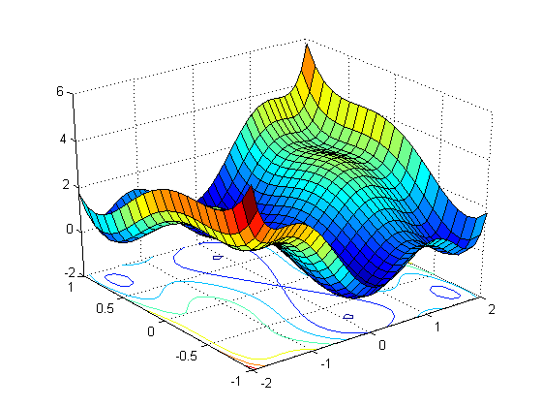
PSO for NN
PSO: type of Swarm Intelligence (biomimetic: bird swarms, fish schools)
Models applied to optimisation
Training NN is an optimisation task: PSO could be used for NN training
Notes:
The PSO algorithm iteratively searches for the global minimum of a function in an multi-dimensional space. It was derived from the behaviour of flocks of birds and schools of fish.
https://mag.uchicago.edu/sites/default/files/1508_Kelly_Neural-network.jpg

Slide 8
Points for investigation
“How does the original PSO algorithm compare to conventional methods for training NNs for image processing?”
Is it as accurate?
Is it as efficient?
Is it robust?
Will it work on complex datasets?
Notes:
The other example of biomimicry inspired by biological NN. Inspired by neurons in the brain, we artificial networks of nodes analagous to neurons and weighted edges analagous to synapses which connect the input and output.
NN applications range from image processing and speech recognition to medical diagnosis and various types of forecasting.
Edges are weighted according to importance of certain connections, and hence the weights of these nodes to best map input to output is an optimisation problem. Training the weights of the edges is therefore an optimisation problem and PSO can be used to solve it.
https://mag.uchicago.edu/sites/default/files/1508_Kelly_Neural-network.jpg

Slide 9
2. Results & Insights

Slide 10
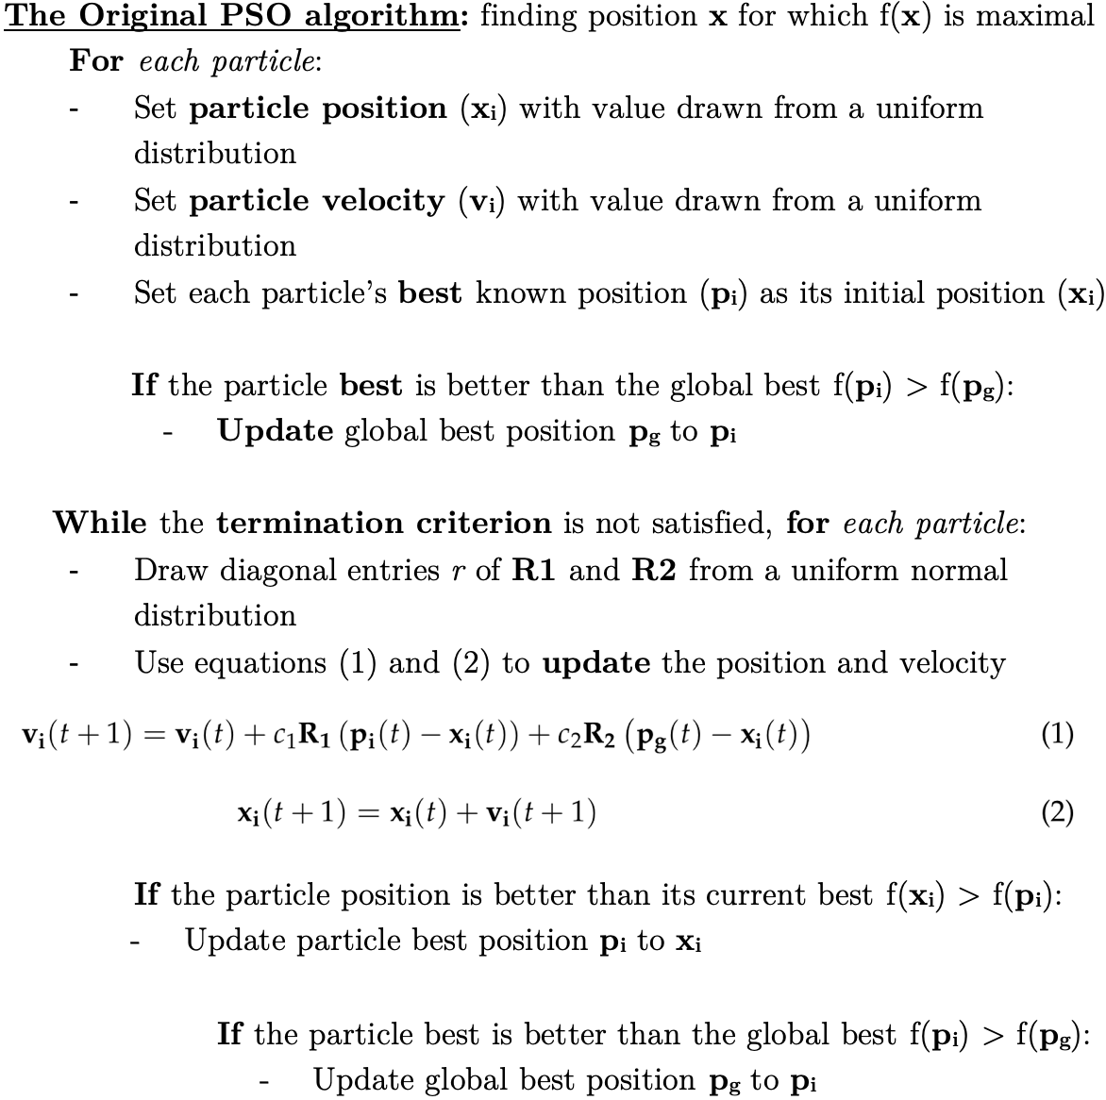
Simulating PSO
Initial position and velocity
Update particle best position and global optimum at every iteration
R₁, R₂, c₁, c₂ and v_{lim}
Notes:
The PSO algorithm iteratively searches for the global minimum of a function in an multi-dimensional space.
The algorithm is initiated by randomly placing many particles, with random velocities, in the search space.
At each step, every particle’s velocity is updated according to its previous velocity, its historically best position and the global optimum amongst all the particles.
Over time, the particles will search the space and converge to the optimal point evaluated, using a given fitness criterion.

Slide 11
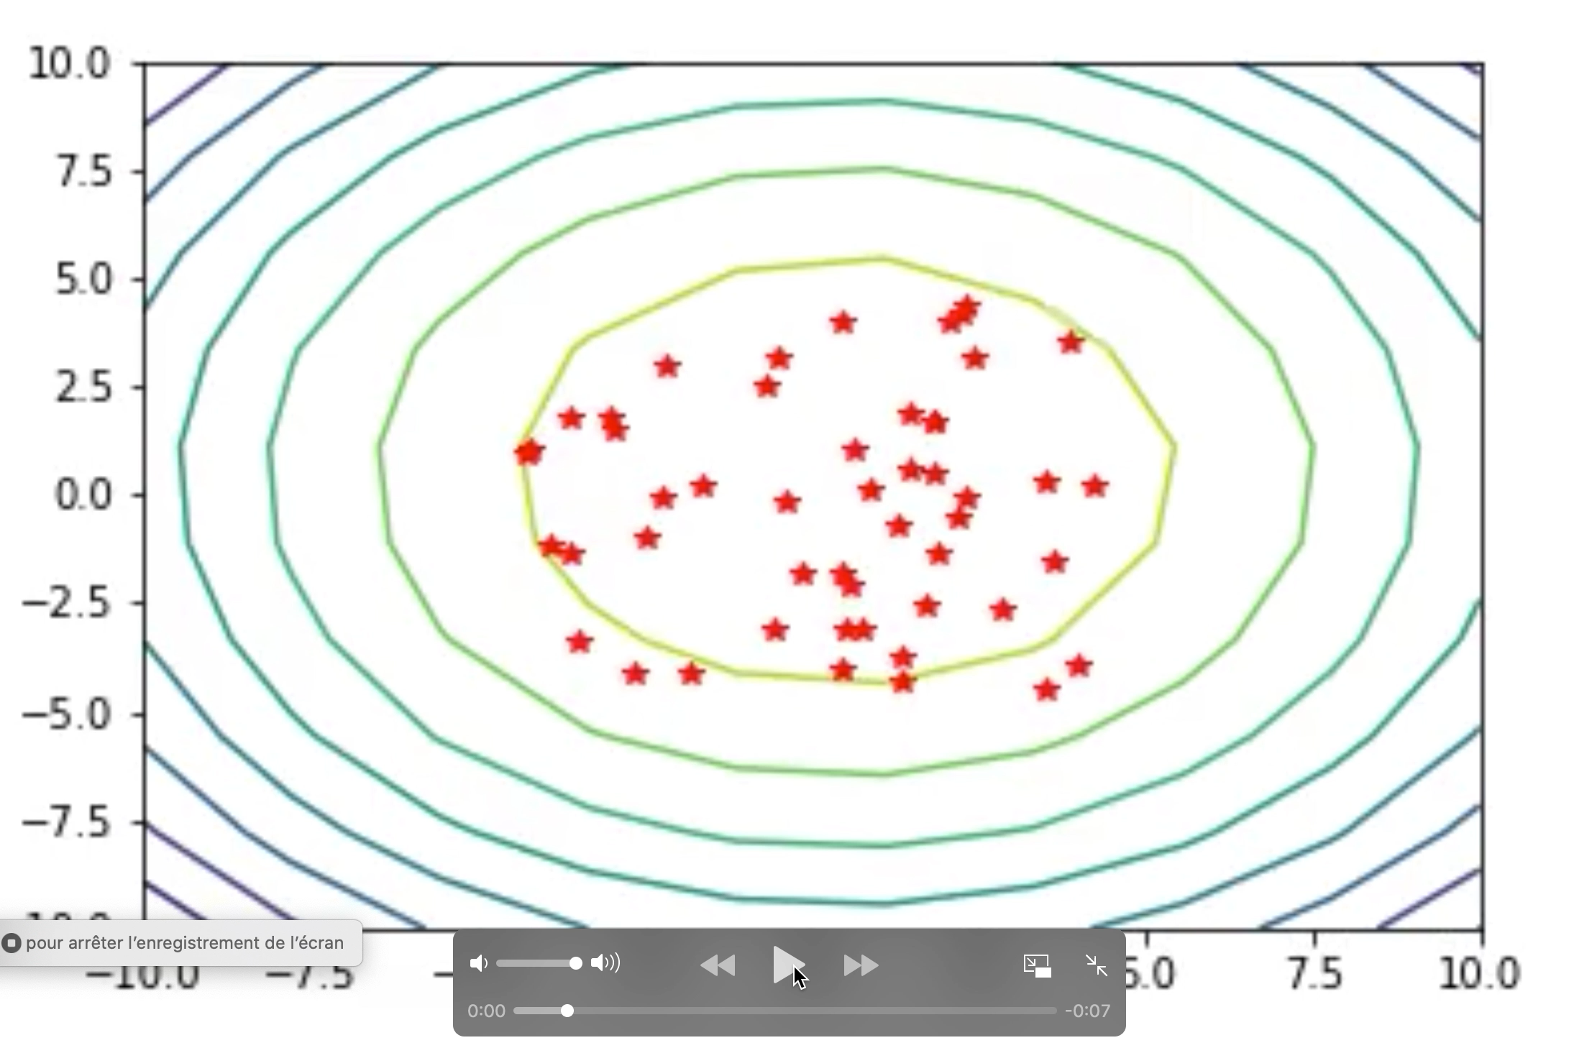
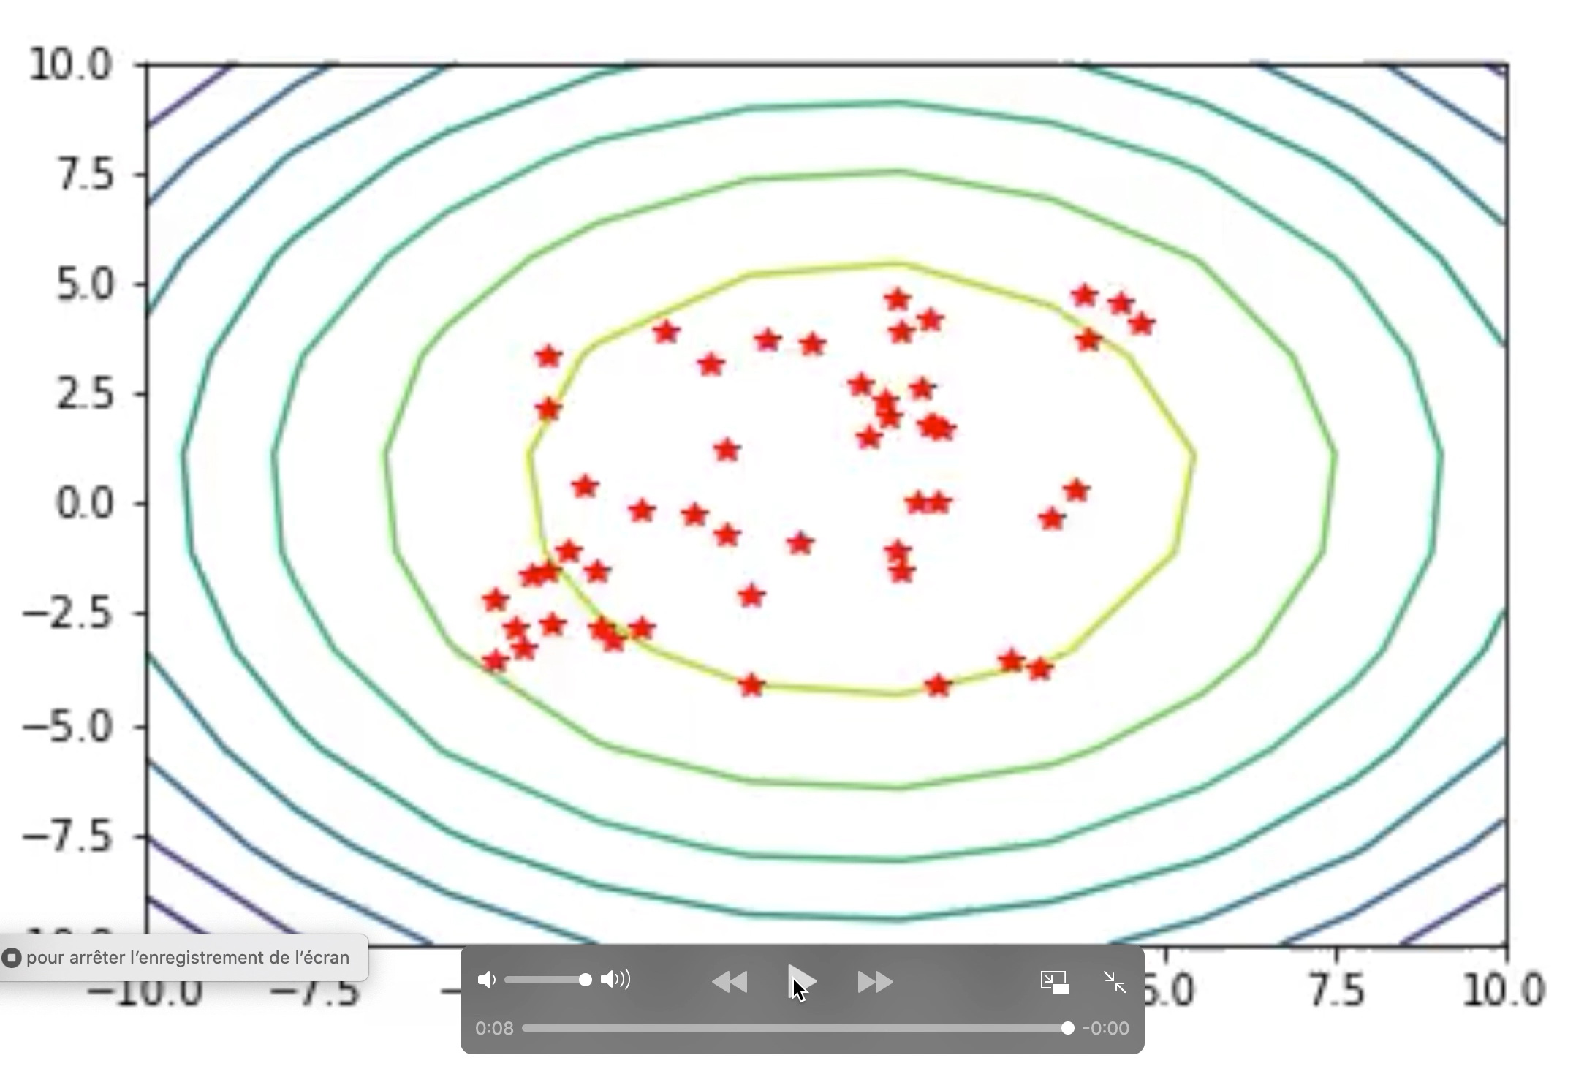
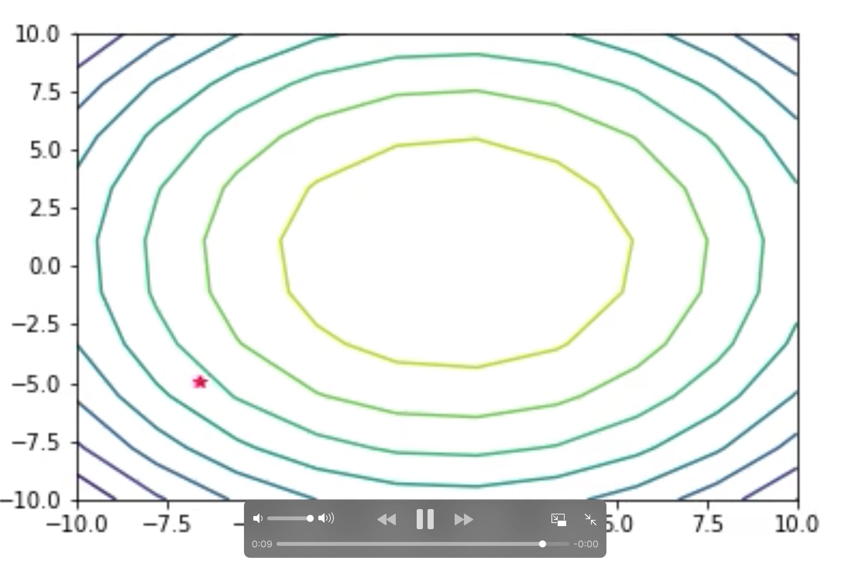
Experimenting with Parameters
Trade-off: time cost vs accuracy

Slide 12
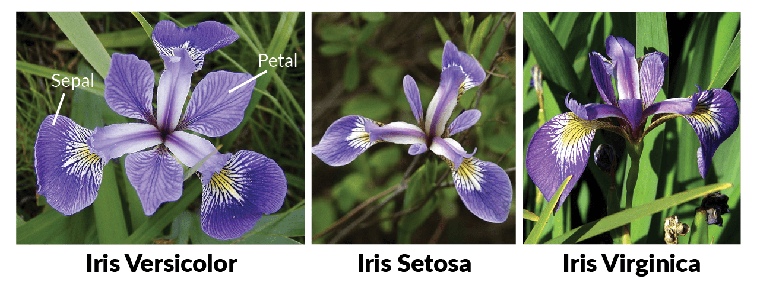
NN for IRIS
Simulated with Tensorflow
IRIS dataset
Backpropagation results
Accuracy = 93.333%
Notes:
We simulated our network using Python with the tensorflow library.
We first use Iris dataset which is a simple classification task that takes 4 numerical inputs and returns one of three flower type labels.
For a comparison measure we used backpropagation to train the weights for the network, we achieved an accuracy of **** ***SHOW GRAPHS***
https://upload.wikimedia.org/wikipedia/commons/thumb/9/9e/Iris_sanguinea.JPG/1200px-Iris_sanguinea.JPG

Slide 13
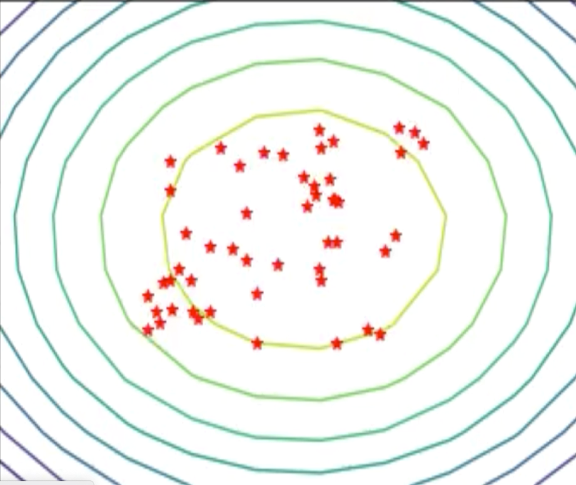
PSO-NN
How do we find f(x)?
x = [
]
3.7
2.3
Often:
x = [
]
2
3
1
0
3
2
5
7
4
…
Notes:
Optimization is done in exactly the same way as before.
Have a bunch of points in space.
First step: what is the value of the function at a point?

Slide 14
x = [
]
2
3
1
0
3
2
5
7
4
3
9
5
5
4
6
3
2
4
7
8
9
8
0
0
1
3
2
5
3
4
7
5
Notes:
Optimization is done in exactly the same way as before. For each particle:
Find function value
Update p_best/g_best if necessary
Calculate velocity using equation
Move to next best position
In this instance, the function value is the efficacy of our neural net. How do we evaluate this?
You can the particles position, and plug it into the weights of the neural network.
You run the neural net over the dataset, and get the error out. This is then the value of the function at that particles position.
You repeat for all the particles, as with the algorithm before. p_best and g_best are updated if necessary as before, and the algorithm changes it’s direction to pick the next one.
In this instance, the speed of the algorithm is mainly determined by the evaluation of the objective function, which is where the TensorFlow backend is so useful.
http://slideplayer.com/slide/9347431/28/images/1/Artificial+Neural+Network.jpg

Slide 15

x = [
]
2
3
1
0
3
2
5
7
4
3
9
5
5
4
6
3
2
4
7
8
9
8
0
0
1
3
2
5
3
4
7
5
Training inputs
f(x)
Predictions

Slide 16
PSO-NN
Objective function is net error
Position is weights and biases
For each particle:
Put the position into the model
Evaluate loss
Notes:
Optimization is done in exactly the same way as before, let’s look back at before:
You can the particles position, and plug it into the weights of the neural network.
You run the neural net over the dataset, and get the error out. This is then the value of the function at that particles position.
You repeat for all the particles, as with the algorithm before. p_best and g_best are updated if necessary as before, and the algorithm changes it’s direction to pick the next one.
In this instance, the speed of the algorithm is mainly determined by the evaluation of the objective function, which is where the TensorFlow backend is so useful.
http://slideplayer.com/slide/9347431/28/images/1/Artificial+Neural+Network.jpg

Slide 17
Our PSO algorithm for our Neural Network
Methods
IRIS dataset: results
Notes:
http://2.bp.blogspot.com/-lhrDQ2Ysh38/UjMmT8r-LYI/AAAAAAAAkuw/_XtgH00EHCA/s1600/Iris+Flowers+24.jpg

Slide 18
3. Conclusion and future steps

Slide 19
Future steps
Quantify effects of:
Velocity limitation
Velocity decay
Fixed hyperparameters (v_{max}, c₁/c₂, n_{particles}, decay rate)
Investigate generalisation to different data sets:
MNIST
CIFAR-10
Depending on results:
Open-source software for understand NN optimization
Notes:
Optimization is done in exactly the same way as before, let’s look back at before:
You can the particles position, and plug it into the weights of the neural network.
You run the neural net over the dataset, and get the error out. This is then the value of the function at that particles position.
You repeat for all the particles, as with the algorithm before. p_best and g_best are updated if necessary as before, and the algorithm changes it’s direction to pick the next one.
In this instance, the speed of the algorithm is mainly determined by the evaluation of the objective function, which is where the TensorFlow backend is so useful.
http://slideplayer.com/slide/9347431/28/images/1/Artificial+Neural+Network.jpg

Slide 20
Our beautiful graph

Slide 21
Parameters

Slide 22
Project output

Slide 23
Conclusion

Slide 24
Particle Swarm Optimisation for Neural Networks
4G4 Group Presenation
Group 8: Kimberly Barker, Louise Aumont and William Halfpenny
Notes:
LOUISE
https://www.howitworksdaily.com/wp-content/uploads/2015/07/wallpaper-of-a-flock-of-flying-birds-hd-bird-wallpapers.jpg

Slide 25
“How does the original PSO algorithm compare to conventional methods for training NNs for image processing?”
Notes:
LOUISE
https://www.stratio.com/wp-content/uploads/2019/02/Birds-blog.jpg
https://www.extremetech.com/wp-content/uploads/2015/10/AI.jpg

Slide 26
Simulating PSO
Swarm intelligence (SI), collective intelligence of simple homogeneous entities.
PSO is an example of SI applied to flocking birds and schools of fish
Application as an optimisation algorithm
Notes:
KIM
Swarm intelligence (SI) is the name given to the phenomenon where a group of simple homogeneous entities interact to perform a complex task together, without any central control system. These entities, known as "agents", individually follow simple rules, unaware of the global intelligent system created by the local, and partially random, coordination between them. SI is observed in nature in the collective behaviour of ant colonies, flocks of birds and many more animal groups. Artificial SI is an area of biomimetics, which takes inspiration from the principles of swarming behaviour, in applications ranging from simulation and artistic purposes, to swarm robotics and optimisation algorithms.
This research project will focus on the use of the particle swarm optimisation (PSO) algorithm. PSO is just one example of SI derived from the behaviour of flocks of birds and schools of fish. (I) Cohesion: birds steer towards the centroid of their neighbours,(ii) Separation: birds maintain relative position to neighbours,(iii) Alignment: birds match their velocity to match that of their neighbours.
PSO is an optimisation algorithm inspired by swarm behaviour which iteratively searches for the global minimum of a function in an multi-dimensional space. The algorithm is initiated by randomly placing many particles, with random velocities, in the search space. At each step, every particle's velocity is updated according to its previous velocity, its historically best position and the global optimum amongst all the particles. Over time, the particles will search the space and converge to the optimal point evaluated, using a given fitness criterion. Especially good for non-differentiable functions or dynamic systems.
https://i.pinimg.com/originals/8f/7f/58/8f7f5804f8bc073ce54f41953799854b.jpg

Slide 27
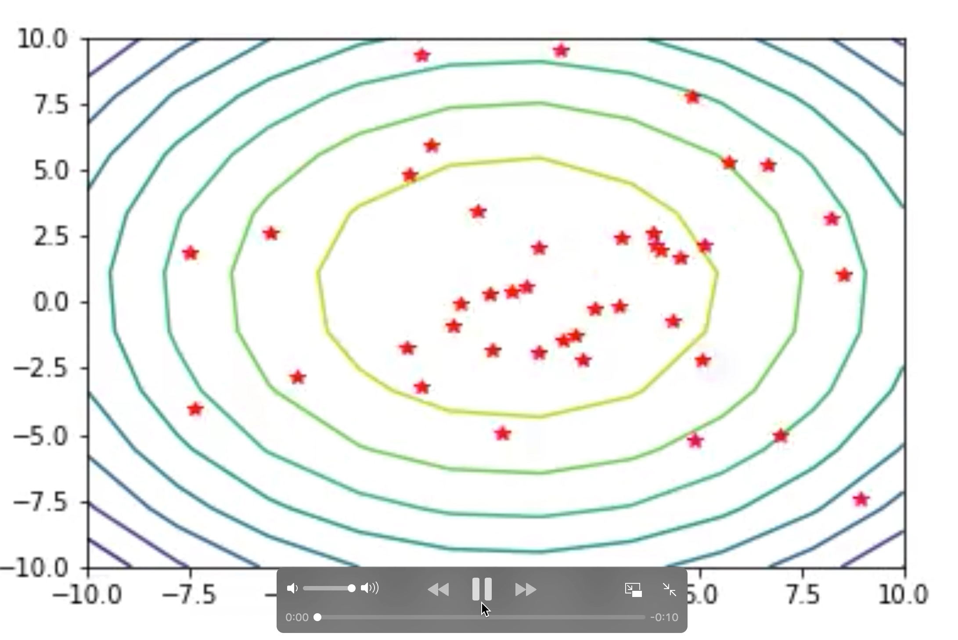
Unbound velocity (no v_{lim})
Particles can miss optimum

